Slide 1

Enginius
Sentiment (Text) Analysis
Minder Chen, CSU Channel Islands
Sentiment 情绪
Copyright (c) 2022, DecisionPro Inc.

Slide 2
Sentiment & Text Analysis Tools
Word Cloud
Valance Analysis
Emotion Analysis
Keyword Analysis
Topic Modeling

Slide 3
Sentiment Analysis: Input Data
\ | Verbatim | Date | Rating
1 | Checkout was too slow | 10/29/2013 | 3
2 | Great selection of office products | 10/26/2013 | 4
3 | Very helpful sales people | 10/26/2013 | 4
4 | Did not have a good selection of Macs | 10/25/2013 | 2
5 | Prices were the best in this area | 10/23/2013 | 4
6 | Limited selection of office furniture | 10/23/2013 | 3
7 | Very good selections of Windows computers, not many Macs | 10/21/2013 | 4
8 | Great place to go for back-to-school shopping | 10/21/2013 | 5
9 | Prices higher than online, but items readily available | 10/20/2013 | 4
10 | Best office supply in town | 10/18/2013 | 4
11 | Very happy with the Dell computer I bought here, reasonable price | 10/15/2013 | 4
12 | Sales person was rude when I asked about a higher end Mac computer | 10/13/2013 | 2
 | 。。。
54 | I was extremely please with the assistance I received and did not feel rushed to make a decision | 8/21/2013 | 5

Slide 4
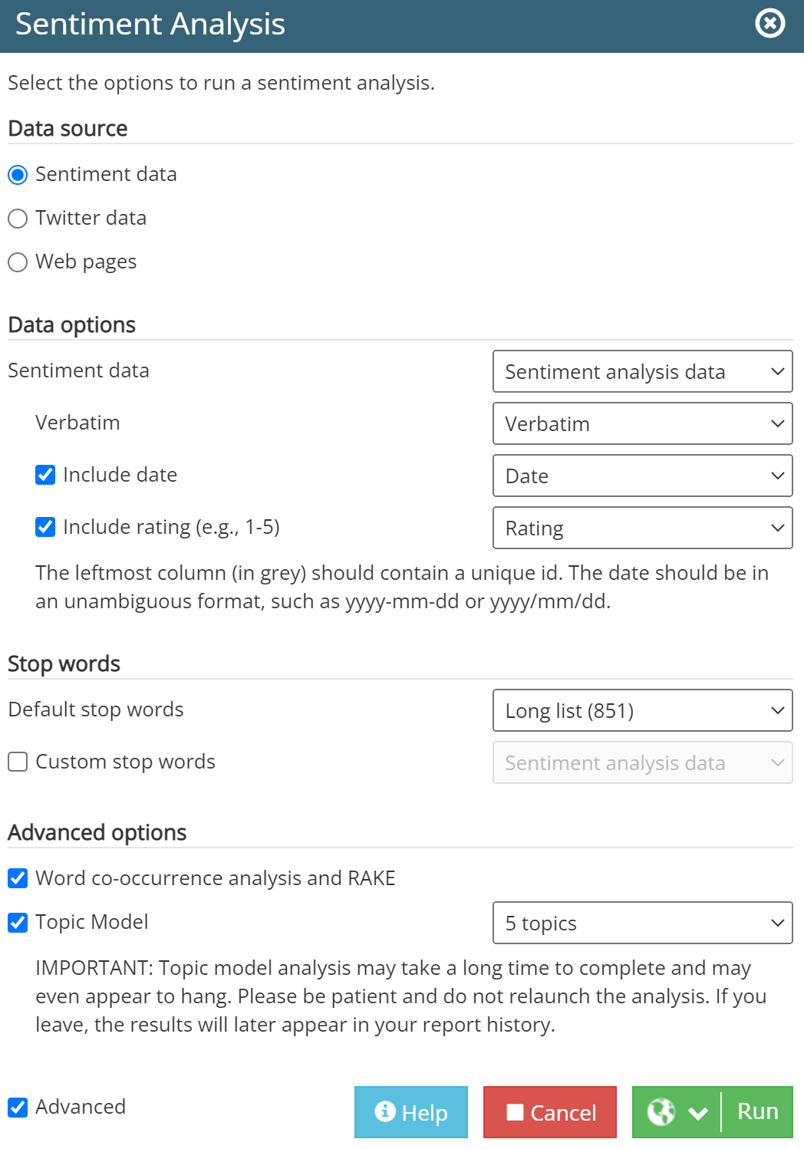
Sentiment Analysis

Slide 5
Word cloud
Text analysis and Word Cloud is the analysis of the input text for frequency of occurrence of various words after preprocessing the text by using such techniques as
removing stop words (typically common words such as the, and, how, but, etc. which are unlikely to add meaning to a sentence), and
stemming to reduce the number of words in a document by getting to the stem or root (e.g., buyer, buyers, buying, etc.. could be put into a stem word “buy.”).
Free online Wordcloud generator
https://www.wordclouds.com/

Slide 6
Who is using word clouds ?
Researchers : for reporting qualitative data
Marketers : for highlighting the needs (gains) and pain points of customers
Educators : to support essential issues
Politicians and journalists
Social media sites : to collect, analyze and share user sentiments
** Text mining and word cloud fundamentals in R : 5 simple steps you should know
http://www.sthda.com/english/wiki/text-mining-and-word-cloud-fundamentals-in-r-5-simple-steps-you-should-know

Slide 7
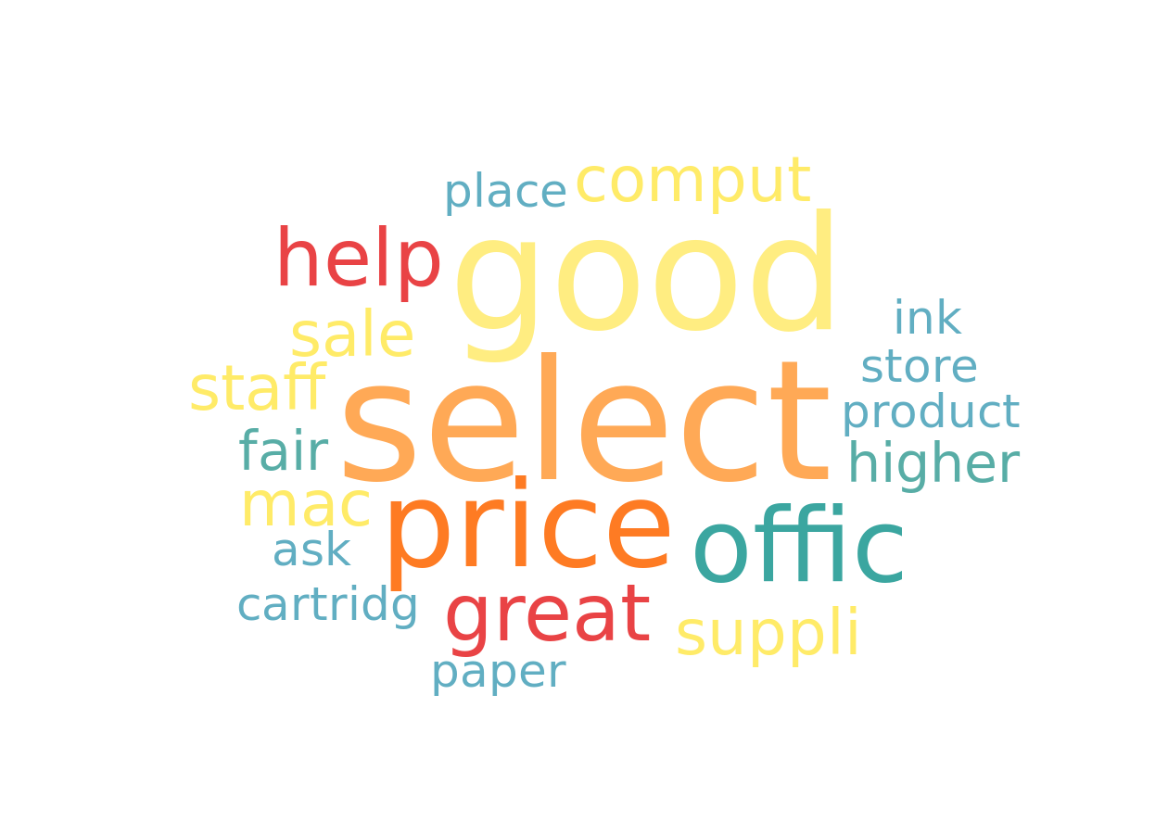
Word cloud
The word cloud represents the most frequently used words inside the corpus (语料库) of texts provided.
The bigger a word appears, the larger the number of times it occurs in the text corpus.

Slide 8
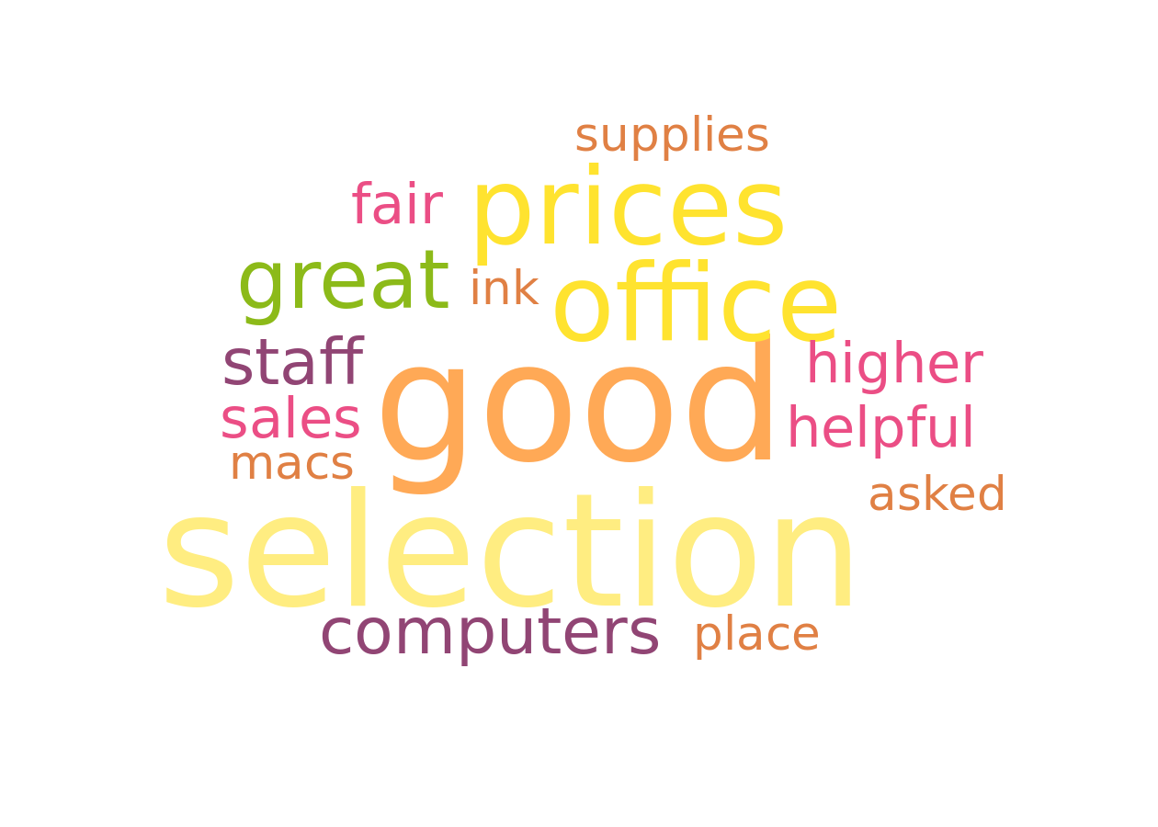
Word cloud without stemming
Stemming
An important preprocessing step is text stemming which reduces words to their root form.
This process removes suffixes from words to make it simple and to get the common origin.
For example, a stemming process reduces the words “moving”, “moved” and “movement” to the root word, “move”.
"Text mining and word cloud fundamentals in R : 5 simple steps you should know"
http://www.sthda.com/english/wiki/text-mining-and-word-cloud-fundamentals-in-r-5-simple-steps-you-should-know
The word cloud represents the most frequently used words inside the corpus of texts provided. The bigger a word appears, the larger the number of times it occurs in the text corpus.

Slide 9
Sentiment analysis overview
Sentiment analysis (also known as opinion mining or emotion AI) is the use of natural language processing, text analysis, computational linguistics, and biometrics to systematically identify, extract, quantify, and study affective states and subjective information.
Sentiment analysis is widely applied to voice of the customer materials such as reviews and survey responses, online and social media, and healthcare materials for applications that range from marketing to customer service to clinical medicine.

Slide 10
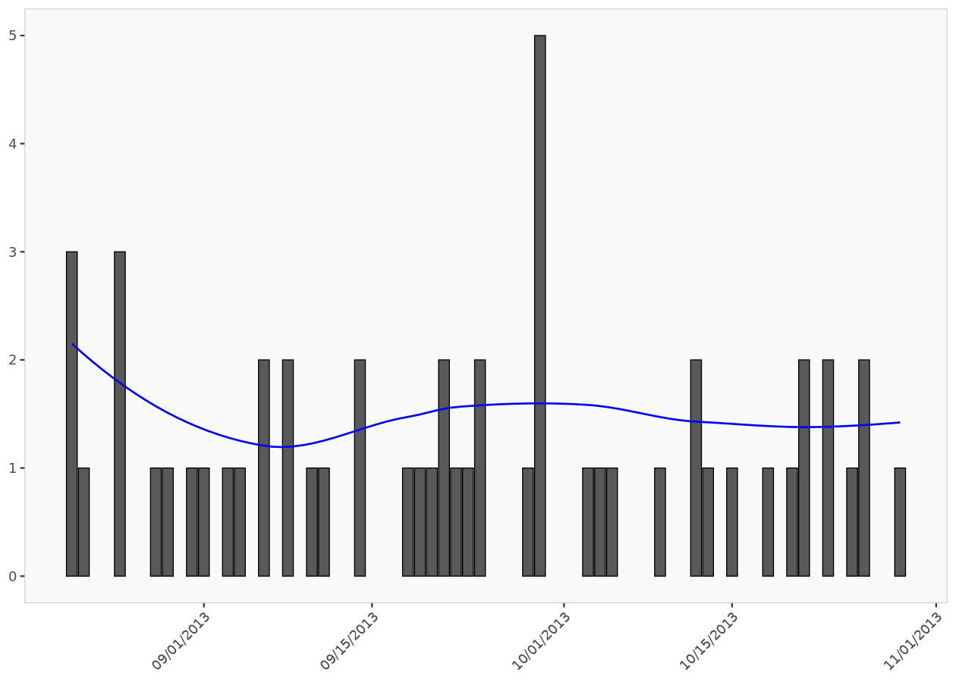
Post frequency
The post frequency histogram indicates the daily frequency of posts. The blue smoothing line helps visualize the trend.

Slide 11
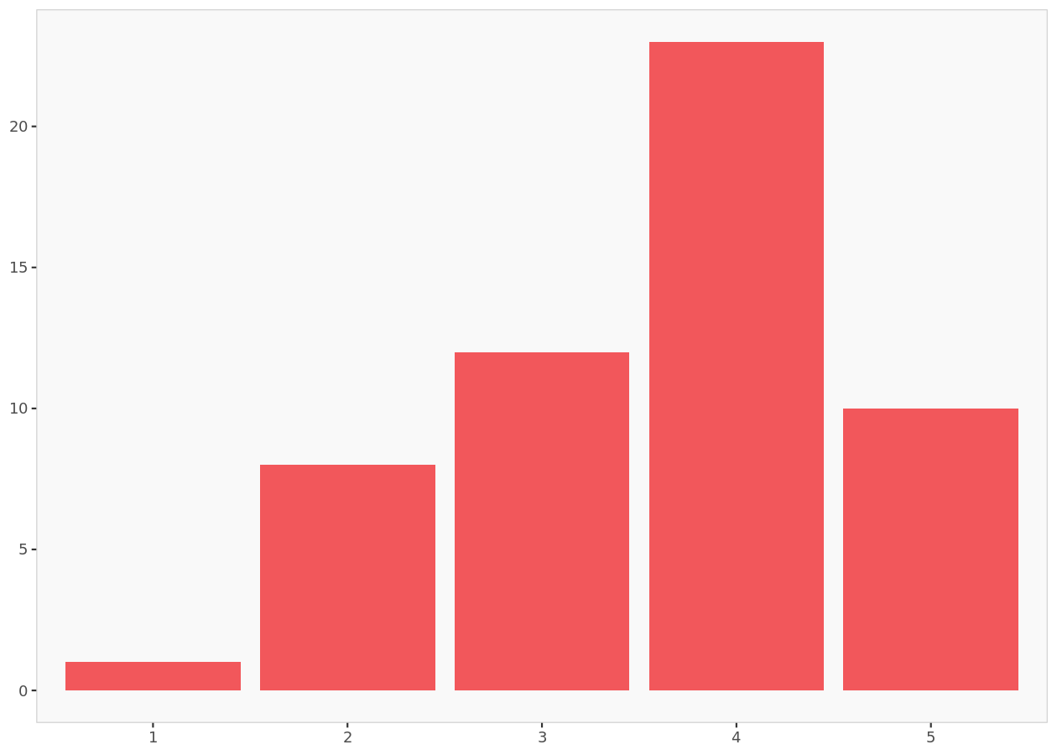
Rating (1-5) histogram
The rating histogram indicates the number of posts categorized by their ratings.

Slide 12
Rating frequency
 | Frequency | Relative frequency
Total | 54 | 100%
1 | 1 | 2%
2 | 8 | 15%
3 | 12 | 22%
4 | 23 | 43%
5 | 10 | 19%
Row names indicates the rating value, then frequency gives the number of post associated to this rating.

Slide 13
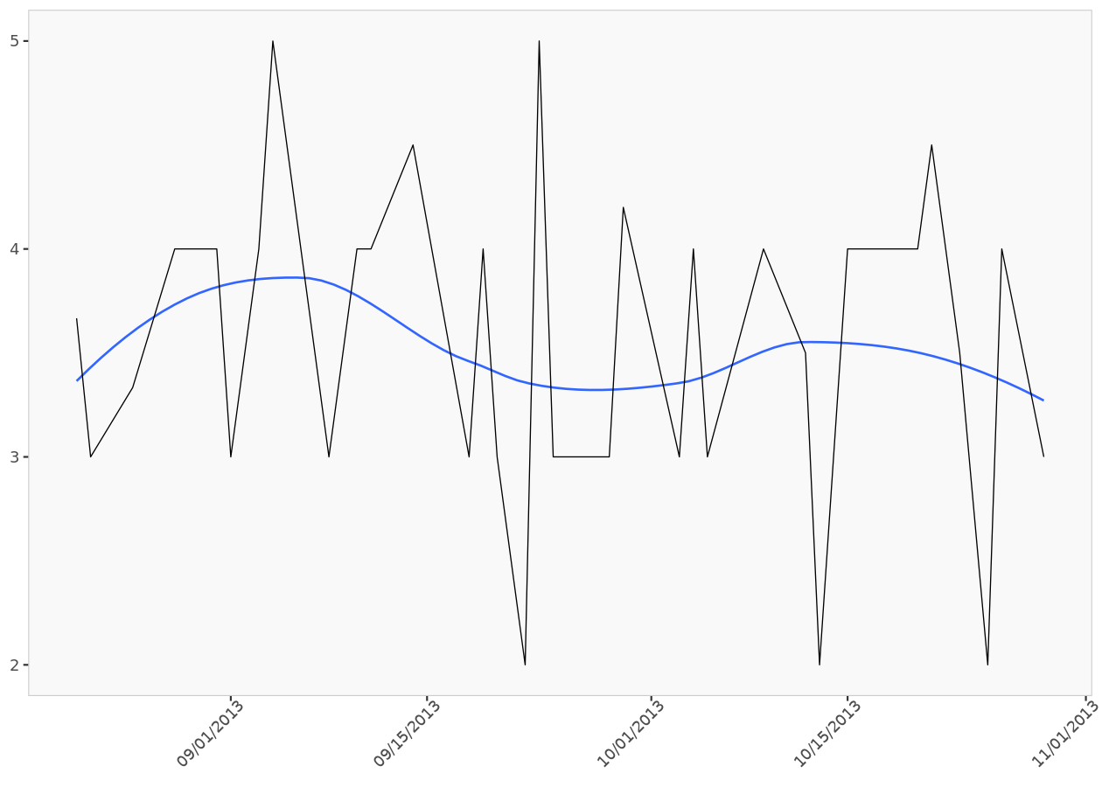
Average rating
The average rating graph indicates for each date the average rating of the posts. The blue smoothing line helps to visualize the trend.

Slide 14
Valence analysis
Valence is the technical term for the “subjective inclination” of a document, measured along a Positive/Neutral/Negative continuum. Several dictionaries or lexicons are publicly available (e.g., AFINN, NRC, Bing) which contain the valence weights associated with common words and phrases.
- Enginius Sentiment tutorial
Valence analysis is the task of automatically determining the valence or polarity of a piece of text, whether it is positive, negative, or neutral. However, more generally, it refers to determining one's attitude towards a particular target or topic.
Saif M. Mohammad, Sentiment Analysis: Detecting Valence, Emotions, and Other Affectual States from Text
https://www.saifmohammad.com/WebDocs/emotion-survey.pdf

Slide 15
Valence repartition
 | Posts count | Relative posts count
Total | 54 | 100%
negative | 12 | 22%
neutral | 3 | 6%
positive | 39 | 72%
The number of posts that fall into different valence categories summarized by their absolute and relative values.

Slide 16
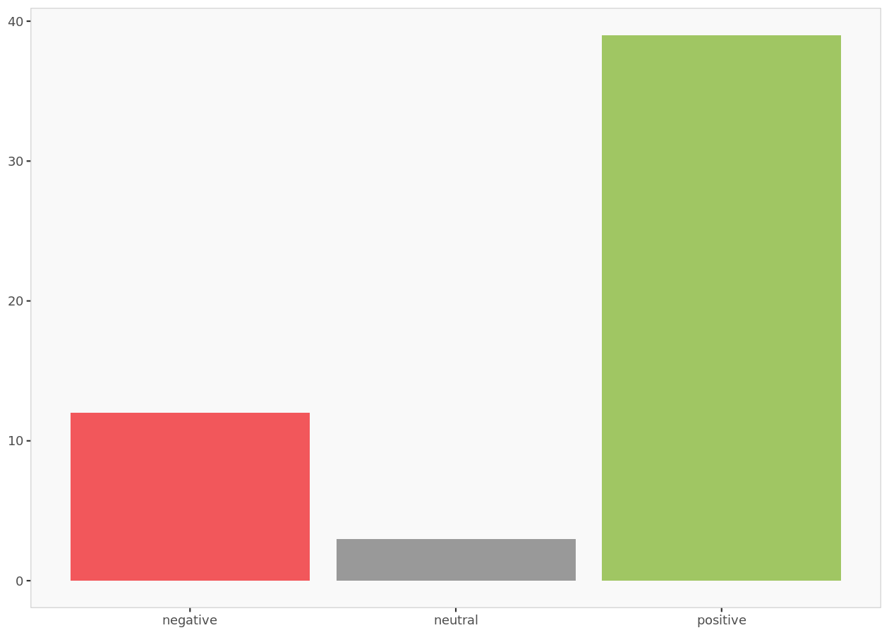
Valence histogram
The valence histogram indicates the number of posts by their valence

Slide 17
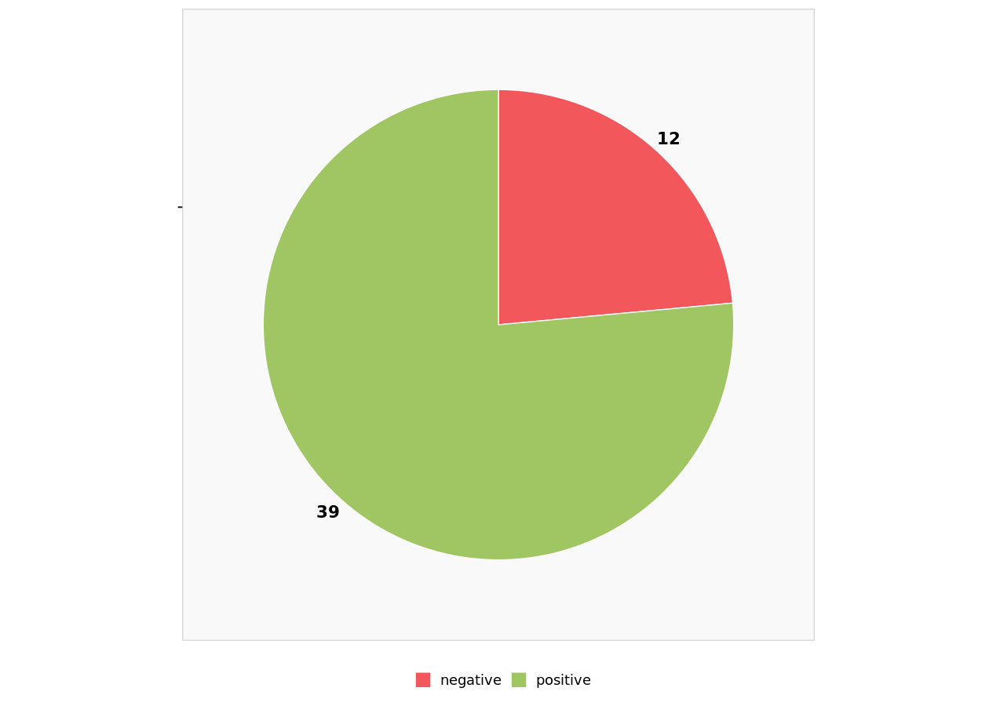
Valence distribution without uncategorized posts
Graphic summary of the relative sizes of the number of posts classified by valence after ignoring posts that could not be categorized (i.e., neutral posts)

Slide 18
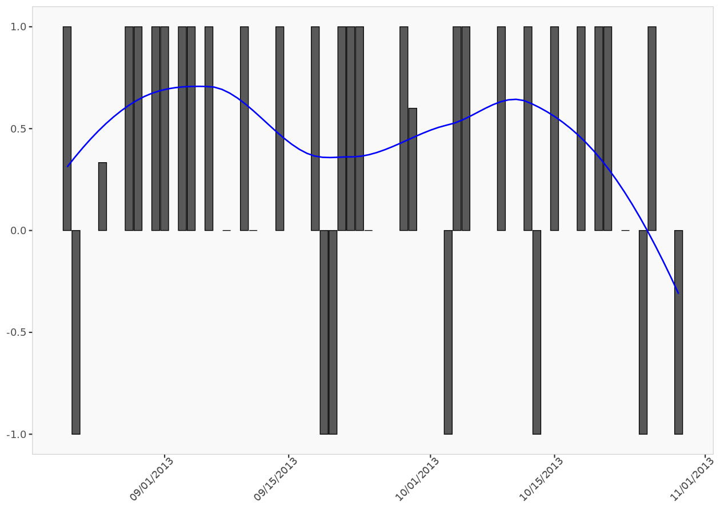
Post valence ratio
The post valence ratio graph indicates the daily average number of positive posts. The blue smoothing line helps visualize the trend.

Slide 19
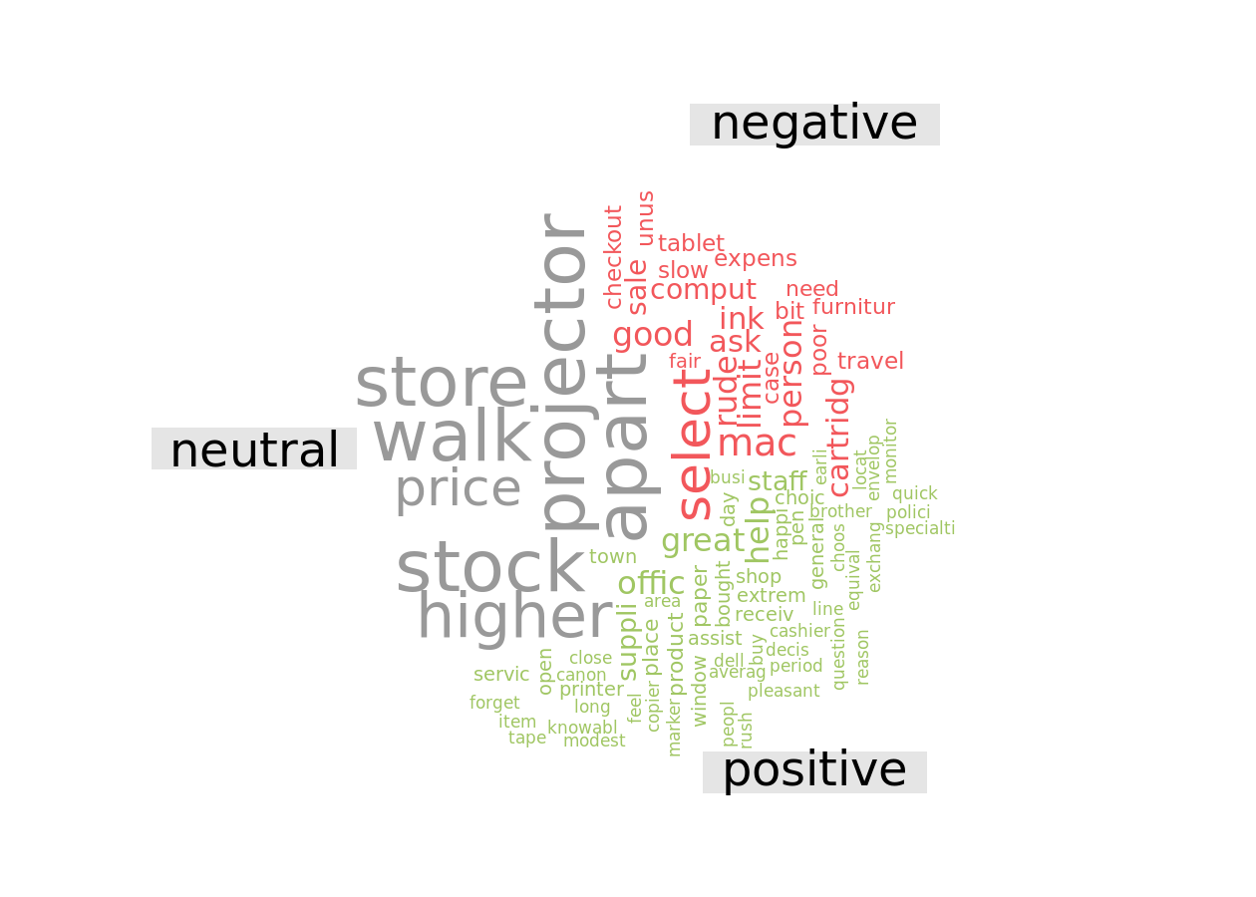
Valence word cloud

Slide 20
Emotion analysis

Slide 21
Emotion repartition
emotion categories | Posts count | Relative posts count
Total | 54 | 100%
anger | 5 | 9%
anticipation | 13 | 24%
disgust | 2 | 4%
fear | 3 | 6%
joy | 6 | 11%
sadness | 2 | 4%
surprise | 8 | 15%
trust | 15 | 28%
The number of posts that fall into different emotion categories summarized by their absolute and relative values

Slide 22
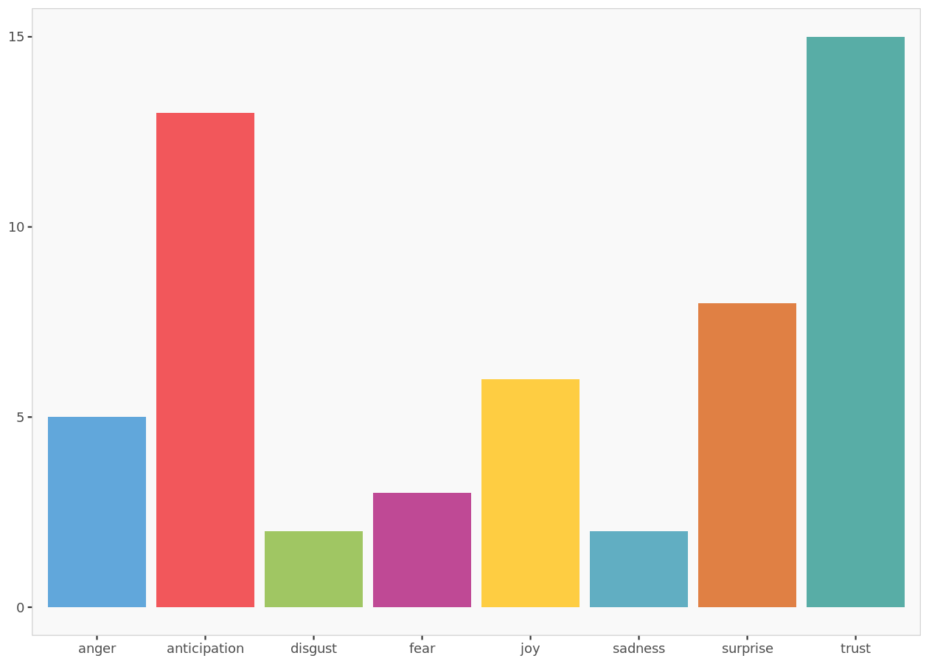
Emotion histogram
The emotion histogram indicates the number of posts by their emotion

Slide 23
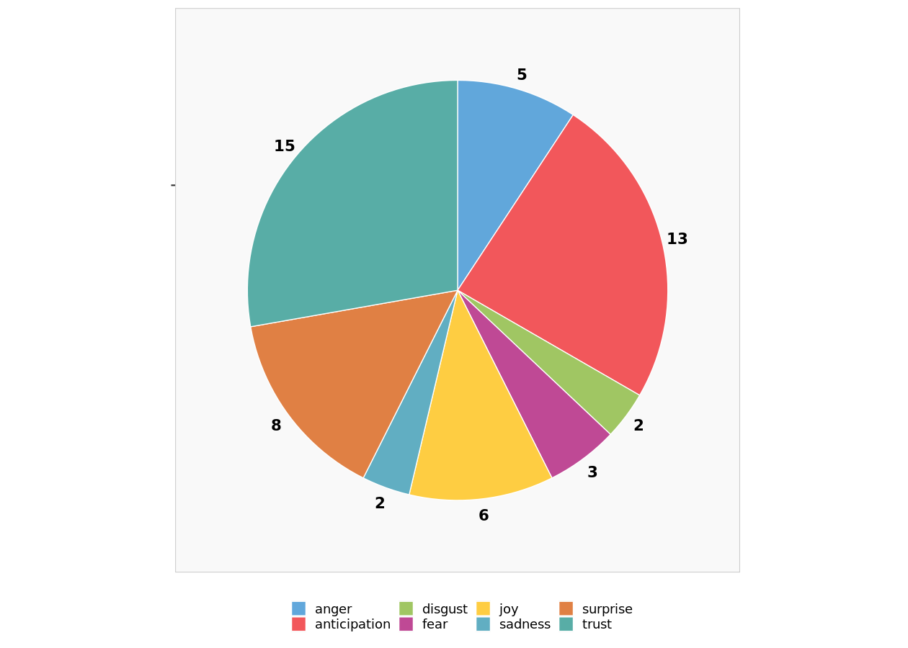
Emotion distribution without uncategorized posts
Graphic summary of the relative sizes of the number of posts classified by emotion after ignoring uncategorized posts

Slide 24
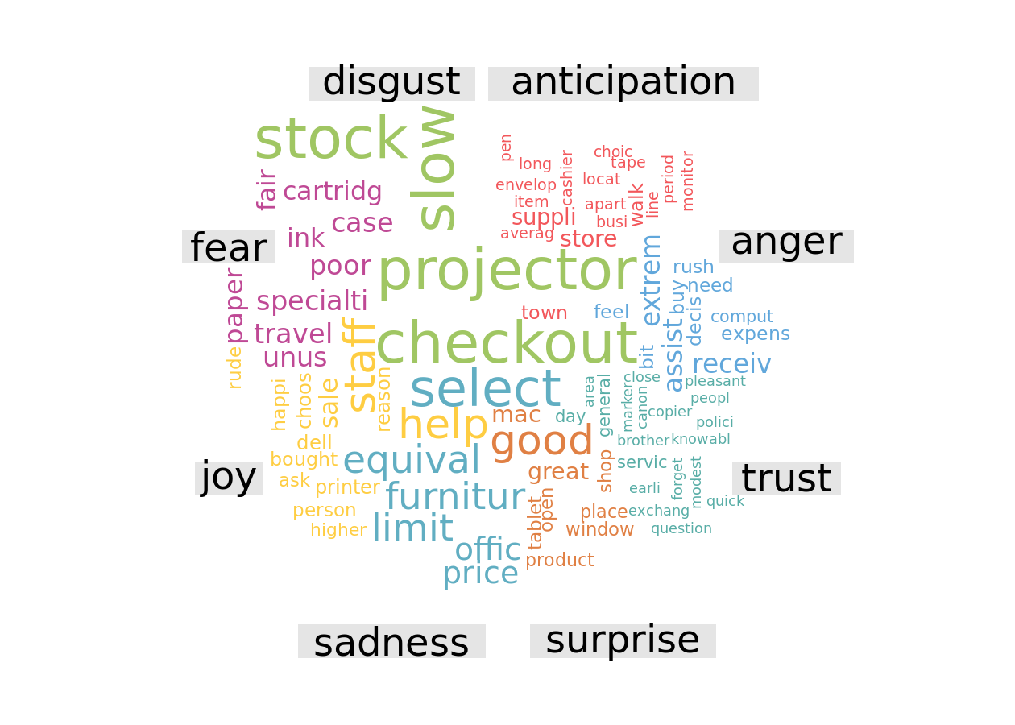
Emotion word cloud

Slide 25
Keyword Extraction
Keyword extraction (also known as keyword detection or keyword analysis) is a text analysis technique that automatically extracts the most used and most important words and expressions from a text.
It helps summarize the content of texts and recognize the main topics discussed.
You can perform keyword extraction on social media posts, customer reviews, surveys, or customer support tickets in real-time, and get insights about what’s being said about your product as they happen and follow them over time.
https://monkeylearn.com/keyword-extraction/

Slide 26
Common Use Cases and Applications
Social media monitoring
Brand monitoring
Customer service
Customer feedback
Business intelligence
Search engine optimization (SEO)
Product analytics
Knowledge management

Slide 27
Keyword Analysis
Statistical Approaches
  Word Frequency
  Word Collocations and Co-occurrences
  RAKE
Linguistic Approaches
Graph-based Approaches

Slide 28
RAKE (Rapid Automatic Keyword Extraction)
RAKE is based on the observation that keywords (a set of contiguous words) rarely contain punctuation or stop words.
A candidate keyword is any set of contiguous words (i.e., 2-gram or bigram for two contiguous words, 3-gram or trigram for three contiguous words, and more generally n-gram) that doesn’t contain phrase delimiters or stop words, i.e., candidate keywords are content-bearing words.
Example bigrams are “customer service,” “merry christmas,” and “thank you.” Example trigrams are “new york times,” “miles per hour,” and “my credit card.”
In Enginius, we set the minimum frequency for words to be included in the rank-ordered list to be at 0.01% of the total word count, and we list up to 20 keywords that contain at most four contiguous words each (4-gram words).

Slide 29
RAKE Example
Sample text
Keyword extraction is not that difficult after all. There are many libraries that can help you with keyword extraction. Rapid automatic keyword extraction is one of those.
Suppose our list of stopwords and phrase delimiters look like these:
stopwords = [is, not, that, there, are, can, you, with, of, those, after, all, one] delimiters = [., ,]
Then, our list of 8 content words, will look like this:
content_words = [keyword, extraction, difficult, many, libraries, help, rapid, automatic]
Then, the algorithm splits the text at phrase delimiters and stopwords to create candidate expressions. So, the candidate key phrases would be the following:
Keyword extraction is not that difficult after all. There are many libraries that can help you with keyword extraction. Rapid automatic keyword extraction is one of those.
https://monkeylearn.com/keyword-extraction/

Slide 30
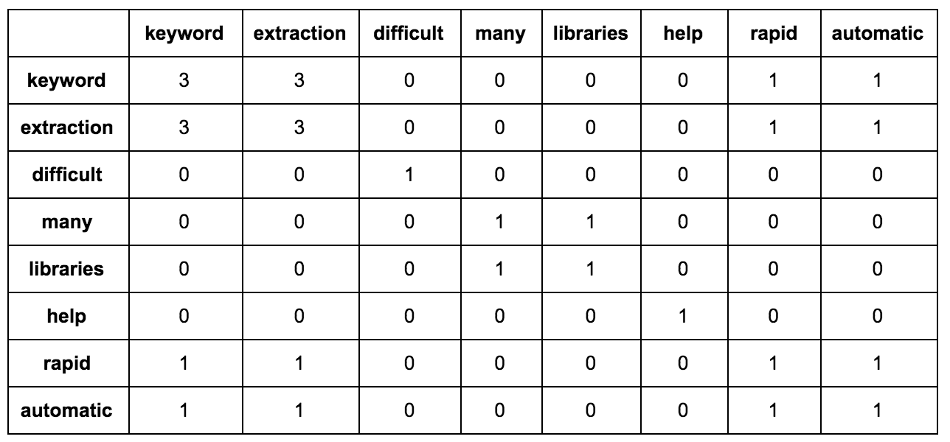
Matrix of Word Co-occurrences 一同出現在Keyphrases的次數
Keyword extraction is not that difficult after all. There are many libraries that can help you with keyword extraction. Rapid automatic keyword extraction is one of those.
Each row shows the number of times that a given content word co-occurs with every other content word in the candidate phrases. For the example above, the matrix looks like this:
Degree
8
8
1
2
2
1
4
4
Frequency
3
3
1
1
1
1
1
1
➔➔

Slide 31
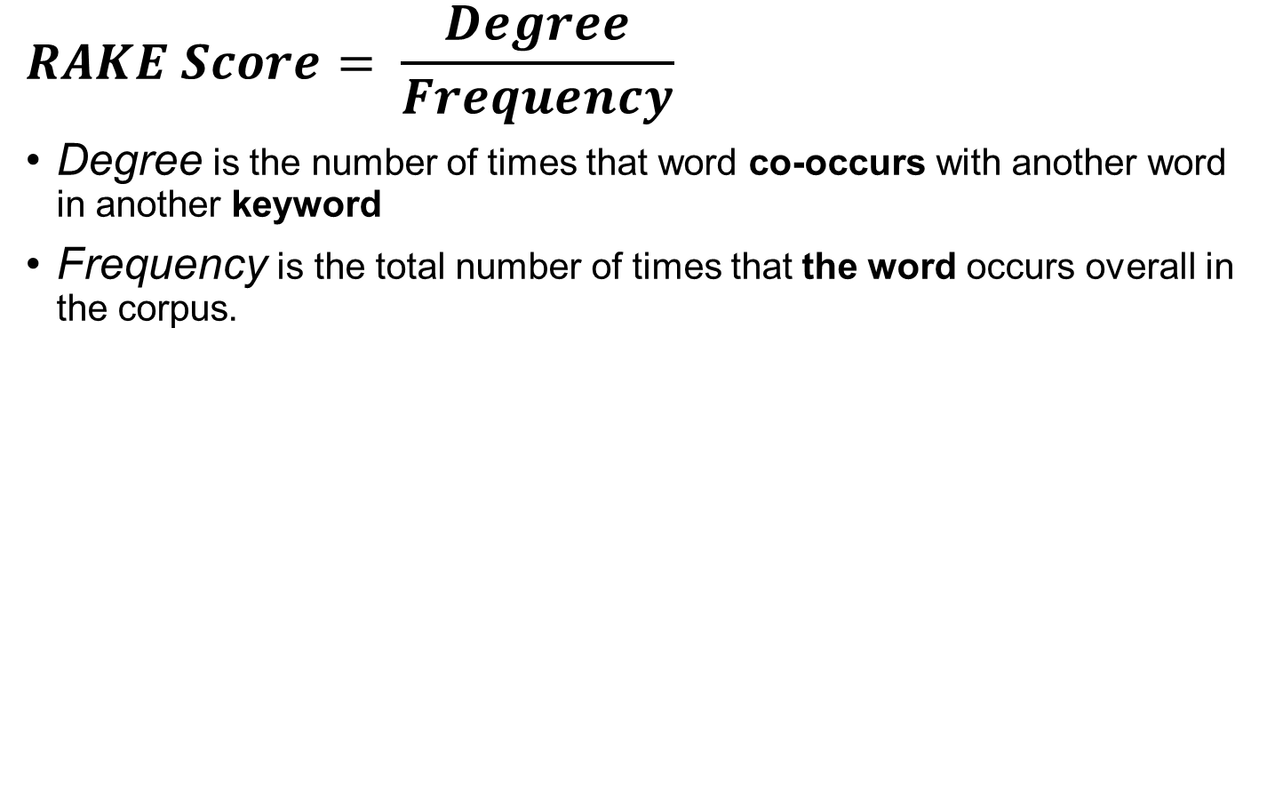
RAKE Score
$$RAKE Score= \frac{Degree}{Frequency}$$
Degree is the number of times that word co-occurs with another word in another keyword
Frequency is the total number of times that the word occurs overall in the corpus.
Keyword extraction is not that difficult after all. There are many libraries that can help you with keyword extraction. Rapid automatic keyword extraction is one of those.
Degree/
8
8
1
2
2
1
4
4
Frequency
3
3
1
1
1
1
1
1
=RAKE Score
2.66
2.66
1
2
2
1
4
4

Slide 32
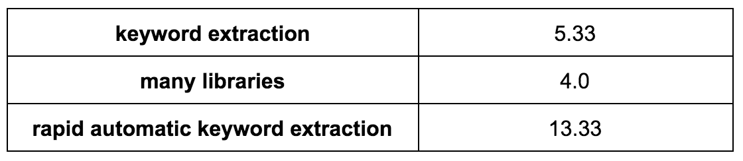
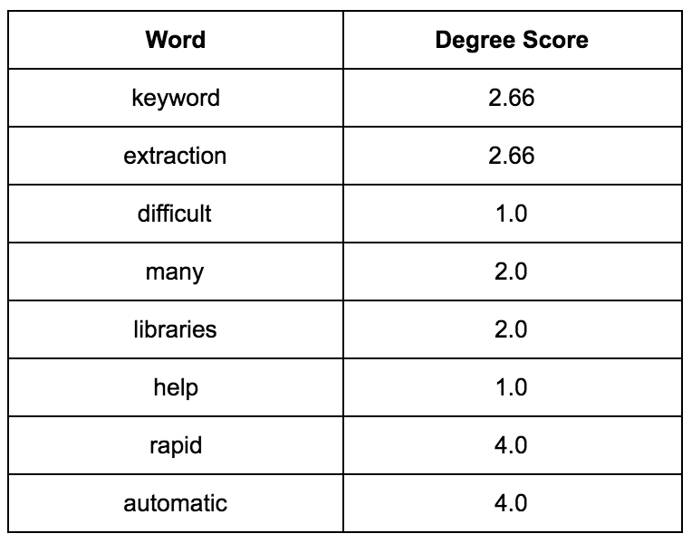
Keywords/Expression Score
Those expressions are also given a score, which is computed as the sum of the individual RAKE scores of words. If we were to calculate the score of the phrases in bold above, they would look like this:
2.66+2.66=5.33
RAKE Score
A keyword or keyphrase is chosen if its score belongs to the top T scores where T is the number of keywords you want to extract.
According to the original paper, T defaults to one third of the content words in the document.

Slide 33
Graph of Word Co-Occurrences

Slide 34
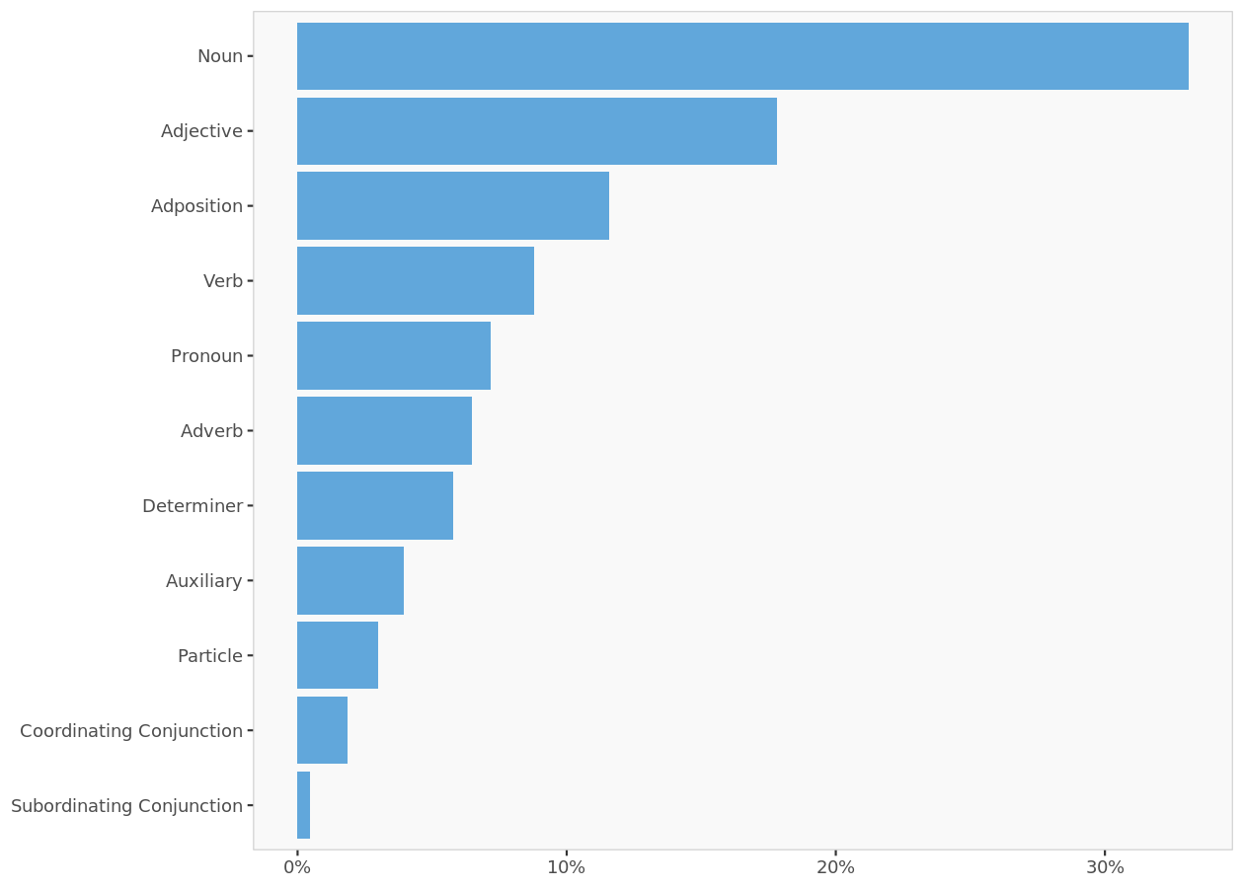
Distribution of Universal Parts of Speech Tags
Nouns, verbs, and adjectives (which are the only words shown in the co-occurrence graphs below) make up about 60% of all the words in this corpus.

Slide 35
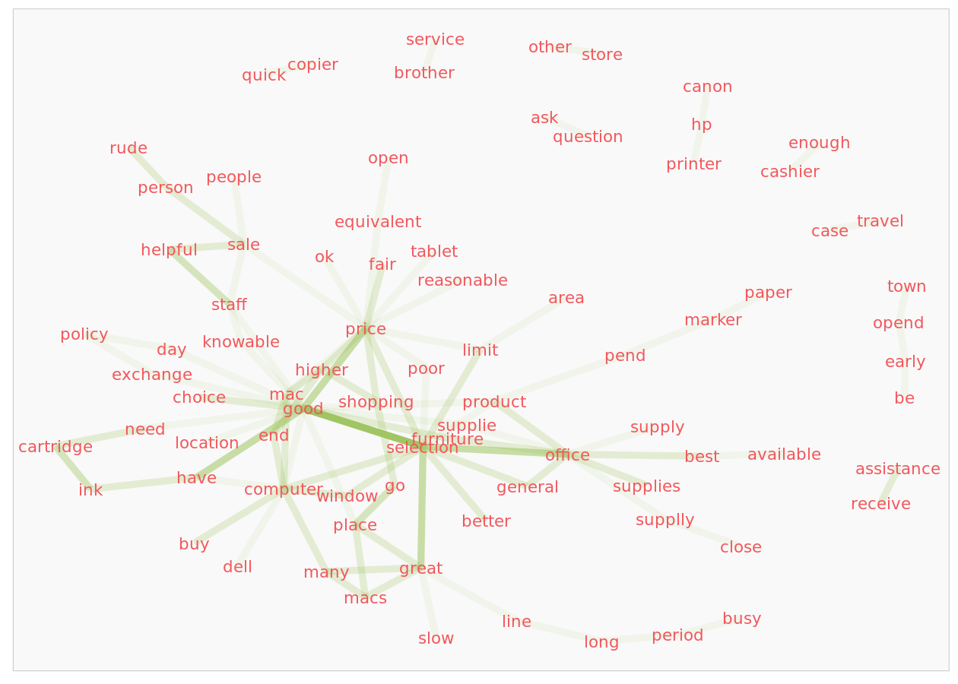
Word co-occurrences across documents (i.e., Words that follow one another)
Includes Nouns, Verbs and Adjectives (retains custom stop-words)
word co-occurrence graph
Summarizes the relative frequencies of pairs of words that are adjacent to each other when we consider the entire corpus as a single document.
For every word, adjacent words provide a context.
The relative frequencies of pairs of words are compiled into a “co-occurrence matrix” and the important elements from this matrix are displayed as a graph.
The strength of a connection is highlighted by the depth of the color of the line connecting two words.

Slide 36
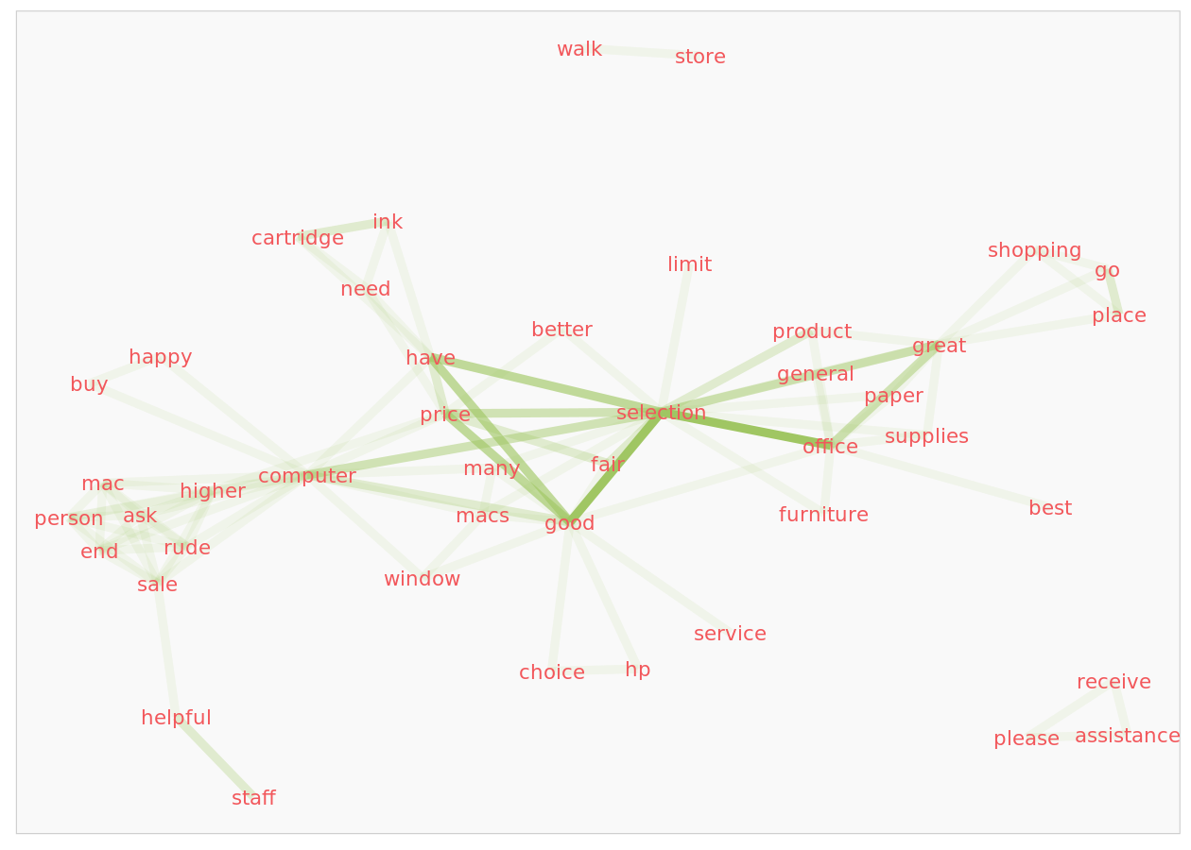
Word co-occurrences within documents (i.e., Words that follow one another)
Includes Nouns, Verbs and Adjectives (retains custom stop-words)
This graph shows word co-occurrence within sentences.
The context is broader than the adjacent word restriction for co-occurrence in the graph we considered above.
The analysis at the sentence level could alter the strengths of the connections between words.

Slide 37
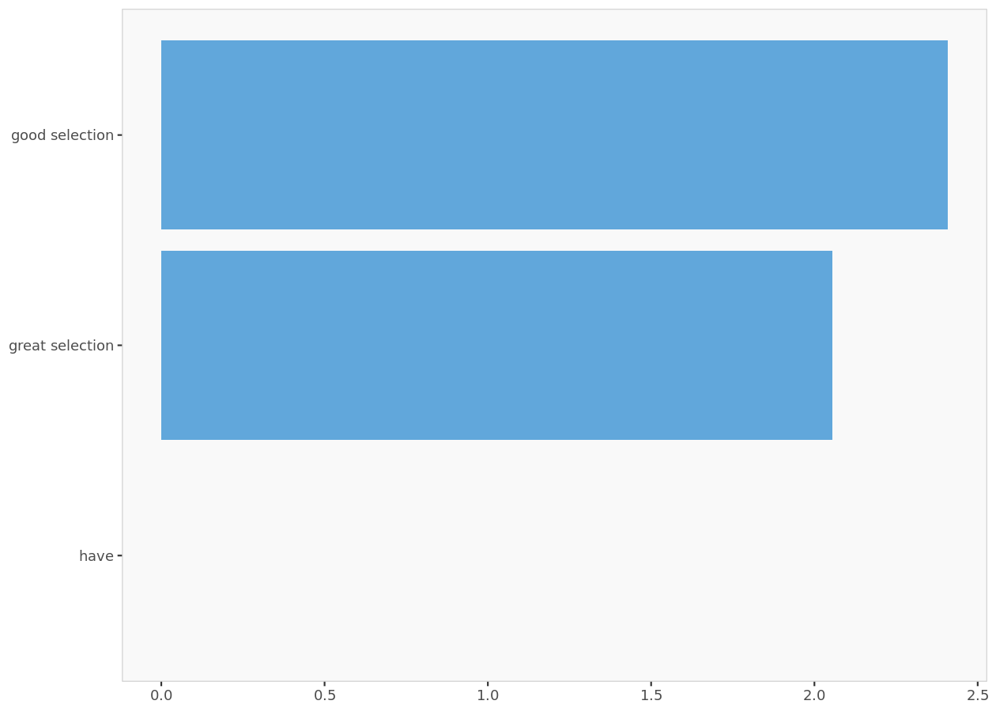
RAKE Analysis (Rapid Automatic Keyword Extraction) -- Keywords with highest RAKE values
Keywords with highest RAKE values.
The top keywords (i.e., contiguous sequence of words ignoring irrelevant words) were identified with minimum frequency of occurrences set to 0.01% of total word count.

Slide 38
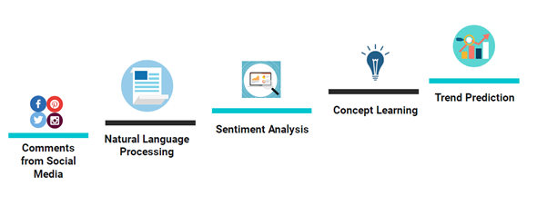
Sentiment Analysis
Challenges in sentiment analysis because of complicated sentences, sarcasm, slangs. For example, in beauty parlance, “It just sucks everything from my pores” would mean a positive sentiment OR “I am dying to use ABC product” would mean a positive sentiment.
https://chistats.com/sentiment-analysis-with-topic-modelling/

Slide 39
Topic Model
Topic modelling is a process to automatically detect topics present in the text and derive hidden patterns in the corpus and thus assist in better decision making. Topics can also be defined as repeated pattern of most occurring terms in a corpus of text.
https://chistats.com/sentiment-analysis-with-topic-modelling/
Topic Modeling, https://rpubs.com/nr2670/week09_tasection

Slide 40
Topic Modeling
Topic modeling is an unsupervised machine learning technique that’s capable of scanning a set of documents, detecting word and phrase patterns within them, and automatically clustering word groups and similar expressions that best characterize a set of documents.
Topic modeling is an ‘unsupervised’ machine learning technique, in other words, one that doesn’t require training.
Topic classification is a ‘supervised’ machine learning technique, one that needs training before being able to automatically analyze texts.
https://monkeylearn.com/blog/introduction-to-topic-modeling/

Slide 41
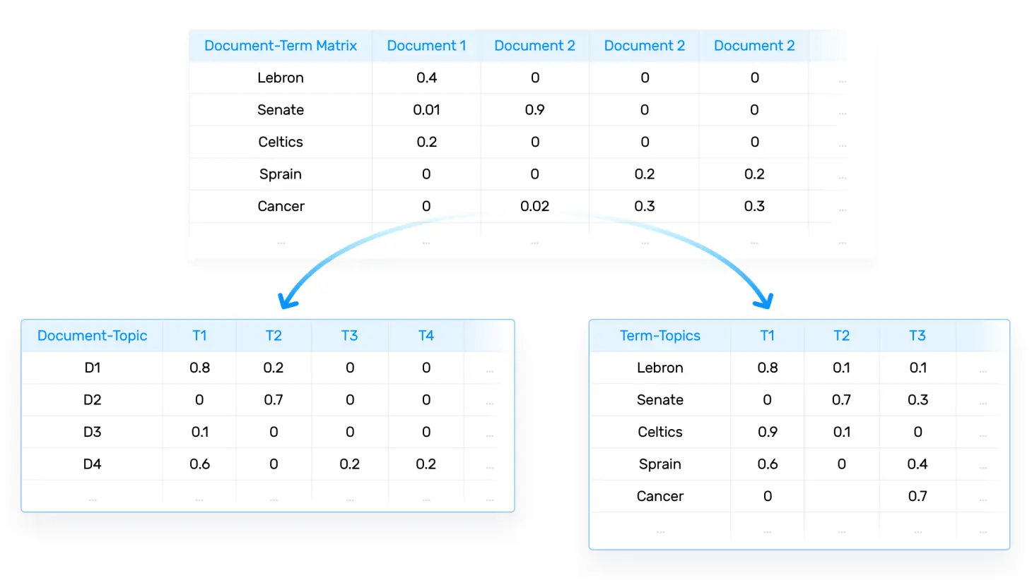
Latent Semantic Analysis (LSA) - 潜在语义分析
3
4
tf-idf. This method computes frequencies by taking into consideration not only how frequent words are in a given document, but also how frequent words are in all the corpus of documents.
The higher the score, the more relevant that word is in that particular document.
** https://monkeylearn.com/blog/introduction-to-topic-modeling/
https://monkeylearn.com/blog/what-is-tf-idf/

Slide 42
Topic Model
Summary of top 15 words (ordered according to their importance) for the top 5 topics in the text corpus (also ordered according to their importance) in the text corpus (ignores custom stop-words)
 | Topic 1 | Topic 2 | Topic 3 | Topic 4 | Topic 5
1 | good | price | suppli | great | select
2 | comput | offic | staff | help | product
3 | limit | higher | store | fair | sale
4 | shop | place | cartridg | paper | mac
5 | town | window | ink | happi | printer
6 | bought | locat | sale | ask | window
7 | rude | polici | mac | servic | item
8 | choic | need | furnitur | day | dell
9 | slow | busi | person | receiv | walk
10 | area | pen | general | brother | open
11 | price | forget | assist | cashier | canon
12 | reason | copier | extrem | marker | staff
13 | walk | modest | checkout | tablet | case
14 | equival | stock | peopl | close | poor
15 | knowabl | feel | ask | earli | buy

Slide 43
Topic Model
Mean topic coherence = -129.076
Coherence is a metric based on the co-occurrence of the top words (say top 15) within a topic in each document of the corpus. For each pair of words in a topic, we compute the log of the probability that a document containing the higher ranked word also contains at least one instance of the lower-ranked word. The overall coherence value for a topic is the sum of scores for each pair of words. A number close to 0 (the highest possible value of this metric) indicates high coherence. We report the average coherence value across the topics.
Mean topic exclusivity = 13.577
Exclusivity, measured using a metric called FREX, captures the extent to which the top words in a topic are exclusive to that topic (i.e., are not as likely to occur in the other topics). The exclusivity score for each top word in a topic is the harmonic mean of two equally-weighted components: (1) the rate at which the word occurs within a topic relative to its rate of occurrence in the other topics, and (2) the frequency (number of times) of a word’s occurrence within a topic relative to its frequency in the other topics. The exclusivity score for a topic is the average of the exclusivity scores of the words in a topic. The computed score is a positive number (> 0), with values substantially greater than 1 indicating a topic’s high exclusivity. We report the average exclusivity value across the topics.

Slide 44
Adequacy of the topic model: Mean topic coherence and Mean topic exclusivity.
The output also includes two metrics to help you assess the adequacy of the topic model: Mean topic coherence and Mean topic exclusivity.
Good models will have a mean topic coherence close to zero and mean topic exclusivity greater than 1.
The model here has a high exclusivity score, suggesting the topics refer to different themes.
There is no clear benchmark to evaluate the computed value of mean topic coherence.
Roughly speaking, with 15 words in a topic (which is what is built into Enginius), a mean topic coherence score that is smaller than -240 (i.e., a larger negative number) suggests that, on average, any pair of words in a topic is likely to occur together in less than 10% of the documents. A score that is smaller than -315 suggests that, on average, any pair of words in a topic is likely to occur together in less than 5% of the documents and the score is -480 for 1%.
On this basis, the topics seem to have an adequate level of coherence. We could consider increasing or decreasing the number of topics to check if that increases mean topic coherence.

